Slide 1
Adrogha Industries limited Location: Nagpur, Maharashtra, India. 440017 Website: www.adrogha.com Email: adroghalimited@gmail.com adrogha@adrogha.limited Contact: +91 82082 44 530 Established Date: 24/03/2023
EPC- Engineering Procurement and Construction

Slide 2
About us
ADROGHA INDUSTRIES LTD. EPC company- Engineering, Procurement, and Construction.
large-scale of Projects, engineering and construction projects, particularly in industries such as energy, infrastructure, and manufacturing, etc
Engineering: The design and planning phase of the project, where the engineering team creates detailed plans and specifications for the project.
Procurement: The sourcing and purchasing of materials, equipment, and services required for the project.
Construction: The actual construction of the project, including the installation of equipment and systems, testing, and commissioning.
Our customers are out most important assets for us. That’s why we work hard to provide the best, most cutting-edge solutions. Your success is our success, which is why we have a team of experts that can handle every area of your plans. We don’t just follow the trends online rather we set them. Together we strive to achieve our common goal that is client’s satisfaction.
Founded in January 2011 as “A RESEARCH” and in August 2017 we are switched to ARAIPL- “AREKAR RESEARCH AND APPLICATION INDIA PRIVATE LIMITED” early years were inspired by the spirit of nationalism. It pioneered several industries of national importance in India.
In more recent times, March 2023 its pioneering spirit has been showcased by companies ADROGHA INDUSTRIES LTD. which made India’s first indigenously developed Business.

Slide 3
Mission, Vision & Values
Mission
Our customers are out most important assets for us. That’s why we work hard to provide the best, most cutting-edge solutions. Your success is our success.
Vision
Together we strive to achieve our common goal that is client’s satisfaction.
Values
Being a great place to work is the difference between being a good company and a great company.

Slide 4
Our History
02/01/2011
2018
2020
24/03/2023
Switched Firm To Company
“A Research” to “Arekar Research And Application (I) Pvt. Ltd.”
Works with Cement plant, power plant, government sector
Consultancy and Execution Many Project In Engineering
First Startup as a
“A Research”
Start works in Fire Fighting and Fire Alarm System
Works with Government sector & Industrial Sector
New Limited Company as a
“Adrogha Industries Limited”
18/08/2017
2019
2021

Slide 5
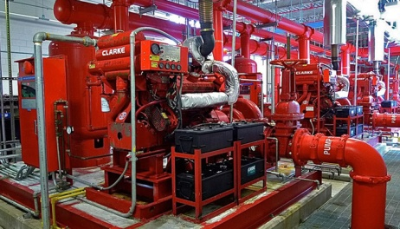
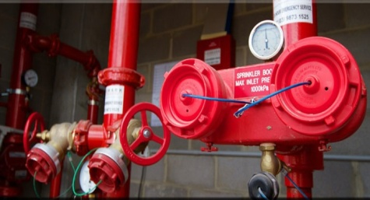
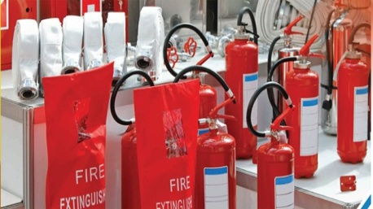
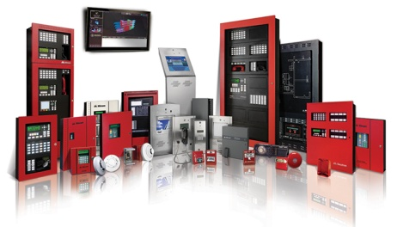
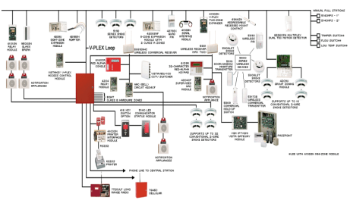
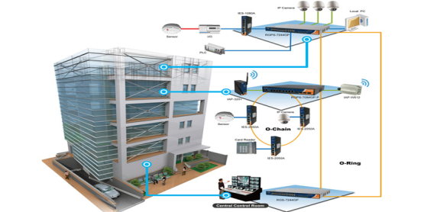
Services
Fire Fighting System
Fire Hydrant System
Fire extinguishers
CCTV System
Fire Alarm System
Fire Detection System
Sprinkler System
Building Management
System

Slide 6
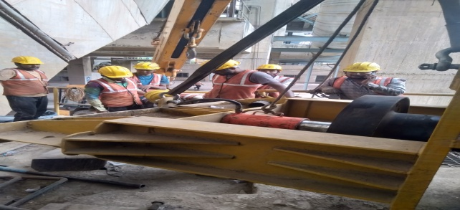
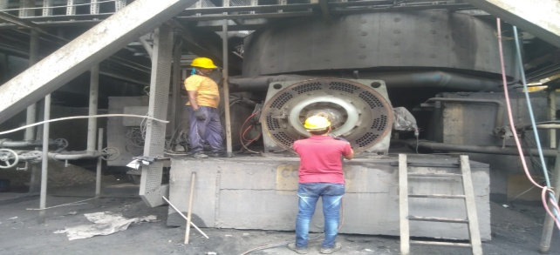
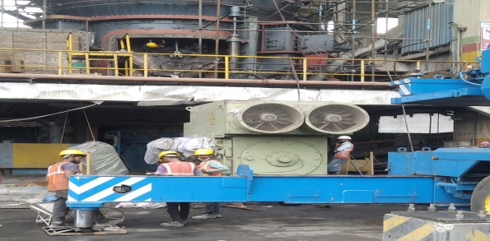
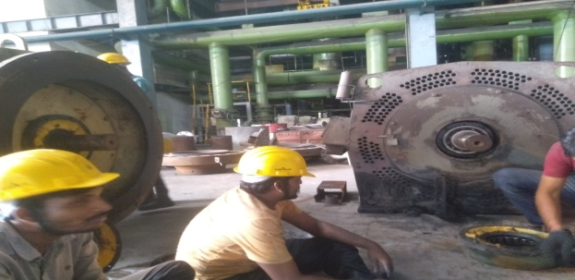
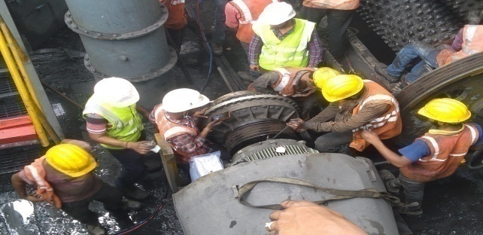
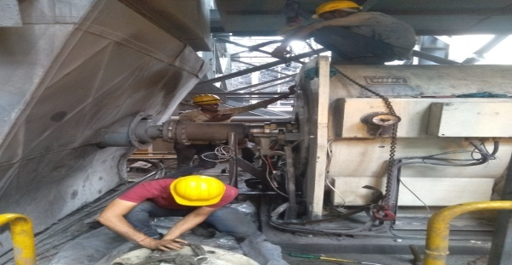
Services
Overhauling & Rewinding of HT, LT, DC - Motors, Generator, Transformer

Slide 7
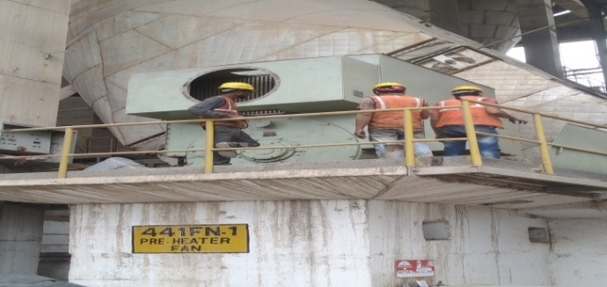
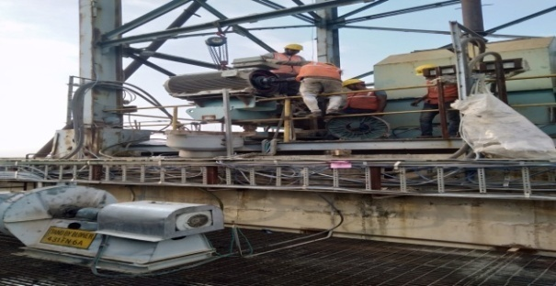
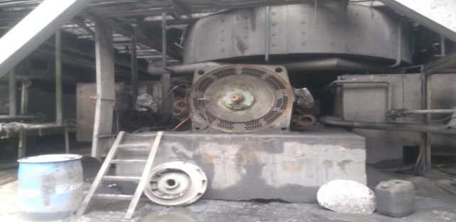
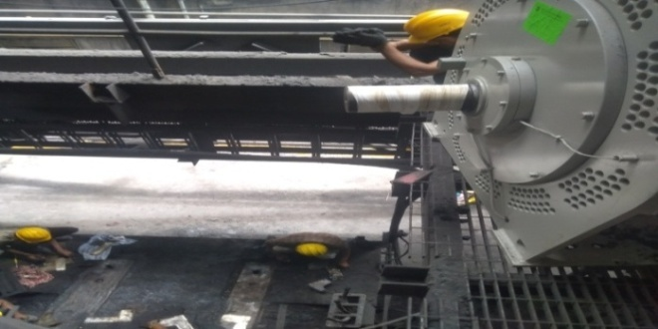
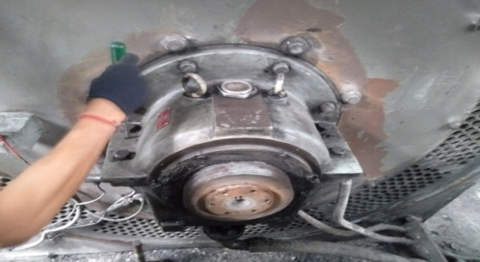
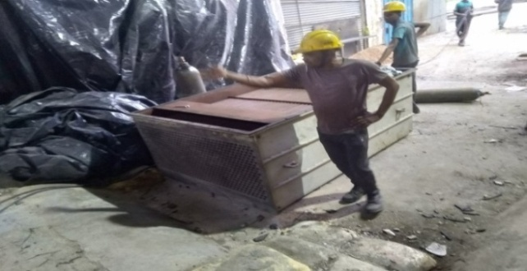
Services
Mechanical & Electrical Engineering Work

Slide 8
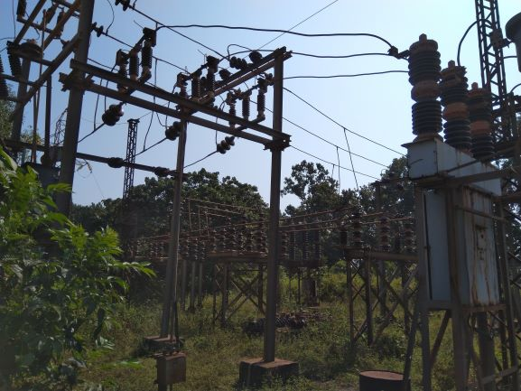
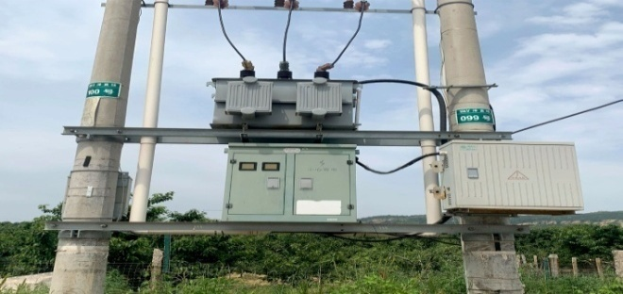
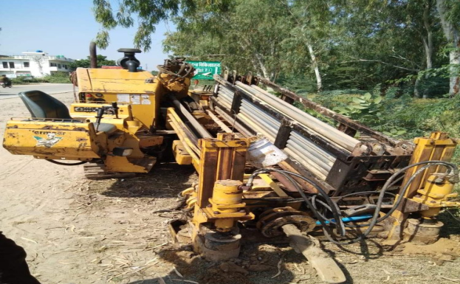
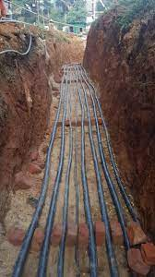
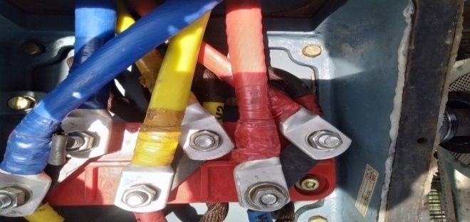
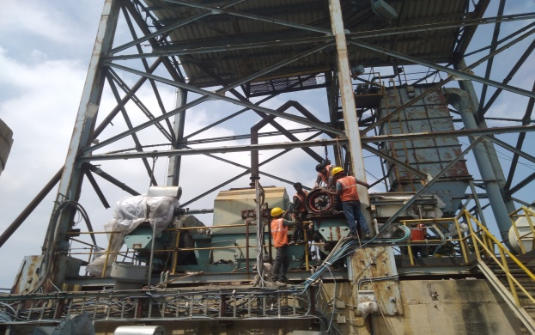
Services
Transmission Line and Cable laying

Slide 9
Adrogha Industries Limited
Civil Engineering Mechanical Engineering Electrical Engineering

